Slide 1
Phase Rule

Slide 2
The heterogeneous equilibria such as vapourization, sublimation, fusion, transition of one phase to another, solubility of solids, liquids, and gases in each other, vapour pressure of solutions, chemical reactions between solids or liquids and gases, and distribution of solutes between phases all have been approached by methods suitable for each particular type of equilibrium. However, it is possible to treat all heterogeneous equilibria from a unified stand point by means of a principle called the Phase Rule.
Phase: This is defined as homogeneous and physically distinct part of a system which is bounded by a surface and is mechanically separable from other parts of the system.
Examples: 1. Ice, water, and vapour is a three phase system. All three phases are homogeneous separately.
2. Completely miscible liquids form one phase system. Water and alcohol mixture form a homogeneous system having no physical boundary and no mechanical separation is possible.

Slide 3
3. NaCl dissolved in water------ one phase system
4. mixture of gases (miscible gases) ------ one phase system
5. immiscible liquids --- benzene and water form two phase system.
Component : The number of components may be defined as the minimum number
of required chemical constituents using which compositions of all phases can be
defined. Usually the number of components is less than the number of chemical
constituents.
Water system ------- Ice(solid) ↔ liquid water ↔ water vapour(gas) --- 3 phases
1(one) component system having same chemical constituent,H₂O.
Decomposition of CaCO₃ in a closed system : CaCO₃(s) ↔ CaO(s) + CO₂(g)
There are three constituents here, but only two will be required to define the total
system. So the minimum required component is 2(two).

Slide 4
Degrees of freedom
The minimum number of independent variables such as temperature(T), pressure
(P) and composition/concentration of phases which must be specified in order to
represent the state/condition of a system.
If in a system there are P number of phases and in each phase there are C number of components, so the number of variables is CP. The main external variables are
P and T. Therefore, the total number of variables = CP + 2 (P,T)
When the phases are in equilibrium, the number of equilibrium exist in total P
phases equals to (P-1) for each component, so for C components, the number of
fixed variables here will be C(P-1).
Variables due to concentration: For example, in α phase the concentration of
different components are x_{1,α} ,x_{2,α} ,x_{3,α} ----- (x is the mole fraction)
for β phase, x_{1,β} , x_{2,β} ,x_{3,β} -----

Slide 5
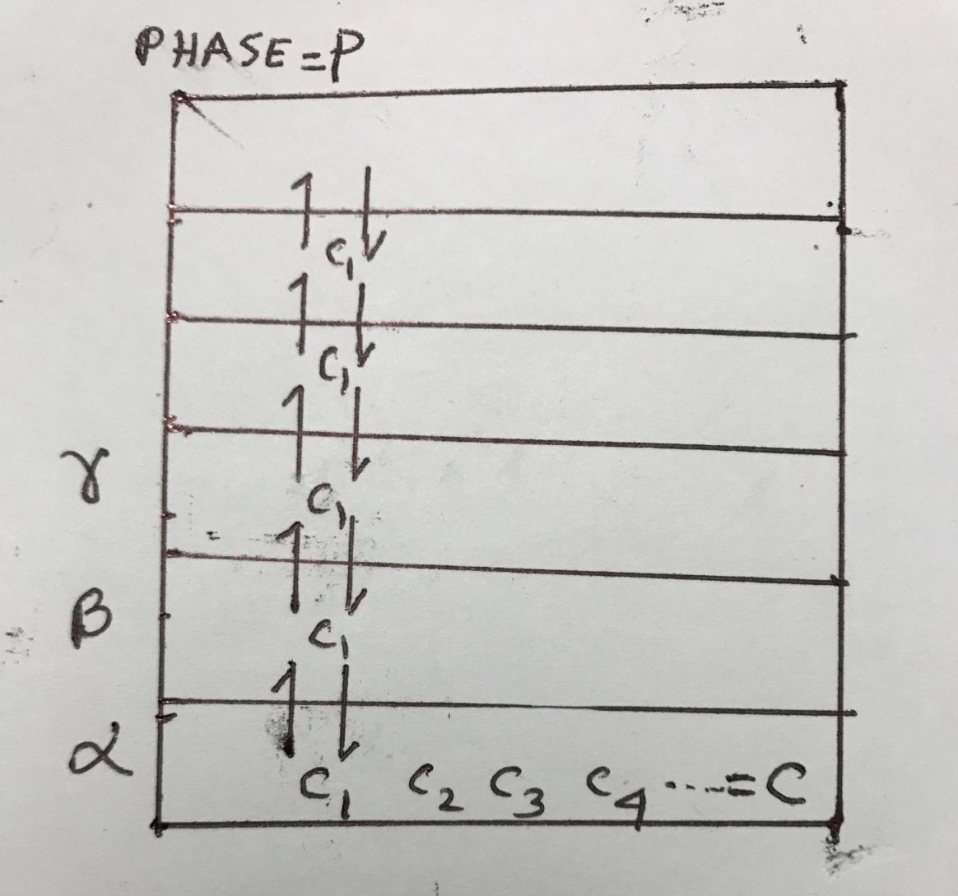

Slide 6
for γ phase, x_{1,γ} ,x_{2,γ} , x_{3,γ} ----------
In each phase the total concentration is 1 (sum of all the mole fractions is 1 only)
therefore for P number phases total concentration variables is PX1= P (fixed variable).
Chemical affinity is another fixed variable which remains zero because no affinity
for reactions to take place in equilibrium condition.
Hence, the number of independent variables = Total variables – fixed variables
The degrees of freedom, F = CP + 2 – {C(P-1) + P}
F = C- P + 2 (Phase Rule)
or F + P = C + 2
F = 0 → nonvariant, it will be a point where we can not change any variable, so
that it will be in equilibrium, temperature and pressure both remain fixed.
F = 1 → monovariant, one of the variables can be changed, other remains fixed.
F = 2 → bivariant, both the variables can be changed, no change in equilibrium.

Slide 7
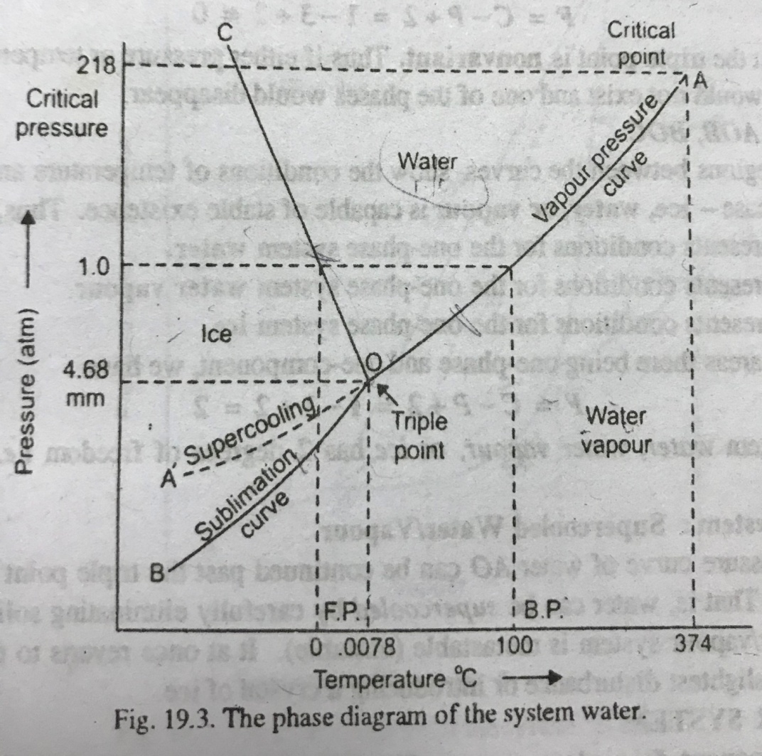
Notes:
The phase diagram of water

Slide 8
Phase diagram of water (one component system) : In the diagram,
AO is the vapour pressure curve, this shows the equilibrium between the liquid
and vapour phases. On this curve F = C – P + 2 or F = 1 – 2 +2 = 1. The degree of
freedom is 1 means only one of the variables can vary, other will be fixed
accordingly. Say at 1 atm (760mm) pressure, the temperature should be 100⁰C. This is boiling point of water. At this, the liquid and vapour will be in equilibrium. If
the pressure is less than 760 mm (say 700mm) and keeping the temperature at 100⁰C, there will be no equilibrium and only one phase will exist.
BO is the sublimation curve, this shows the equilibrium between solid ice and vapour phases. The solid ice converts directly to vapour. On this curve,
F = C – P + 2 or F = 1 – 2 + 2 = 1 , the degree of freedom is 1 (monovariant). At all
the points on this curve, the solid and vapour phases are in equilibrium.
CO is the fusion curve, this curve shows the equilibrium between solid ice and liquid

Slide 9
phases. The solid ice converts directly to liquid water. This is also called melting point curve. At 1 atm pressure and at the 0⁰C temperature, the solid ice melts to liquid or the liquid water freezes to ice. At 0⁰C temperature if the pressure is
increased (say 800mm) the equilibrium will be destroyed and only the liquid phase
exists. An interesting fact is that the liquid water will have higher density
than the solid ice. This is because the solid ice has the greater volume than the
liquid. On this curve CO,
F = C – P + 2 or F = 1 – 2 + 2 = 1 , the degrees of freedom is 1 (monovariant). At all
the points on this curve, the solid and liquid phases are in equilibrium.
Now , let us come to a very interesting point O where all the curves are meeting
together, this is called Triple point. At this point (pressure = 4.58mm, temperature =
0.0078⁰C) all the three phases (solid, liquid and vapour) are in equilibrium. The
degrees of freedom, F = C – P + 2 or F = 1 – 3 + 2 = 0 (nonvariant). No temperature
and pressure can be changed.

Slide 10
A’O is a metastable state, on this curve the liquid and gas will be in equilibrium.
This state is obtained when temperature is lowered down very slowly and carefully
and still water will be in liquid state at less than 0⁰C.
At any point in any particular area in phase diagram, say, between the curves AO and CO (liquid water phase) the degrees of freedom, F = C – P + 2 or F = 1 – 1 + 2 = 2 , the degrees of freedom is 2 (bivariant). The temperature and pressure both can be varied still the phase remains same. Similarly, between the curves CO and BO (solid ice phase) also between AO and BO (vapour phase), the degrees of freedom,
F = 2.
Point A is called the critical point, above this, there will no liquid exist only vapour.
this may be called Super Critical Fluid (SCF). At the critical point the pressure and
temperature are 218 atm and 374⁰C respectively, they are called critical pressure
and critical temperature.

Slide 11
Phase diagram of CO₂ (carbon dioxide)
The phase diagram of carbon dioxide is also a one component system like water.
The diagram is followed:
Next page continued -----

Slide 12
